Slide 1
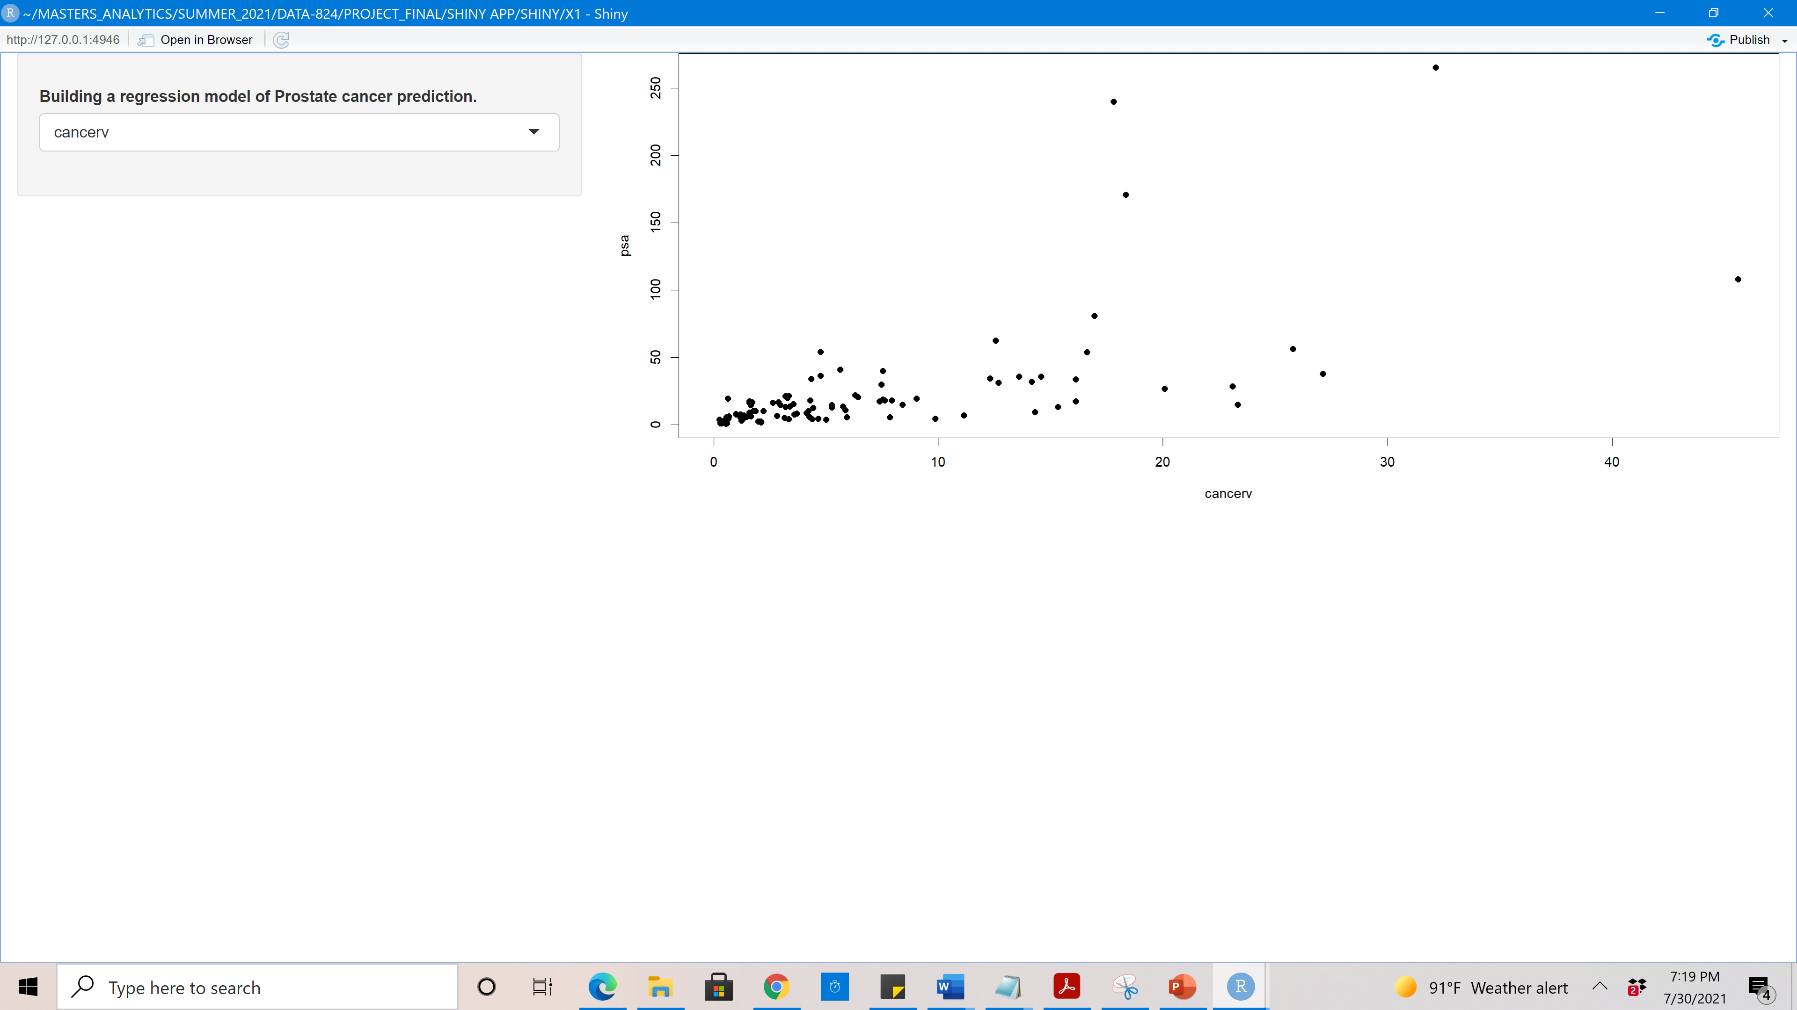
- The current screenshot is generated from shiny app
- The dotplot shows that the residuals are linearly distributed, and we can see some of the outliers.

Slide 2
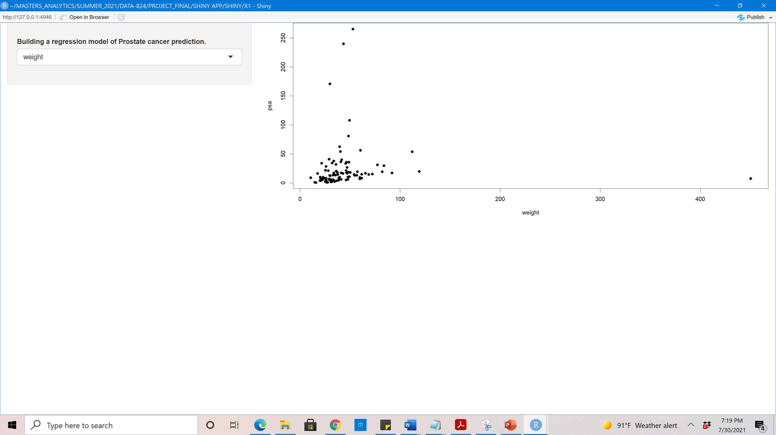
The dotplot shows linear distribution of residuals and most of the residuals are close to zero and we can see outliers.

Slide 3
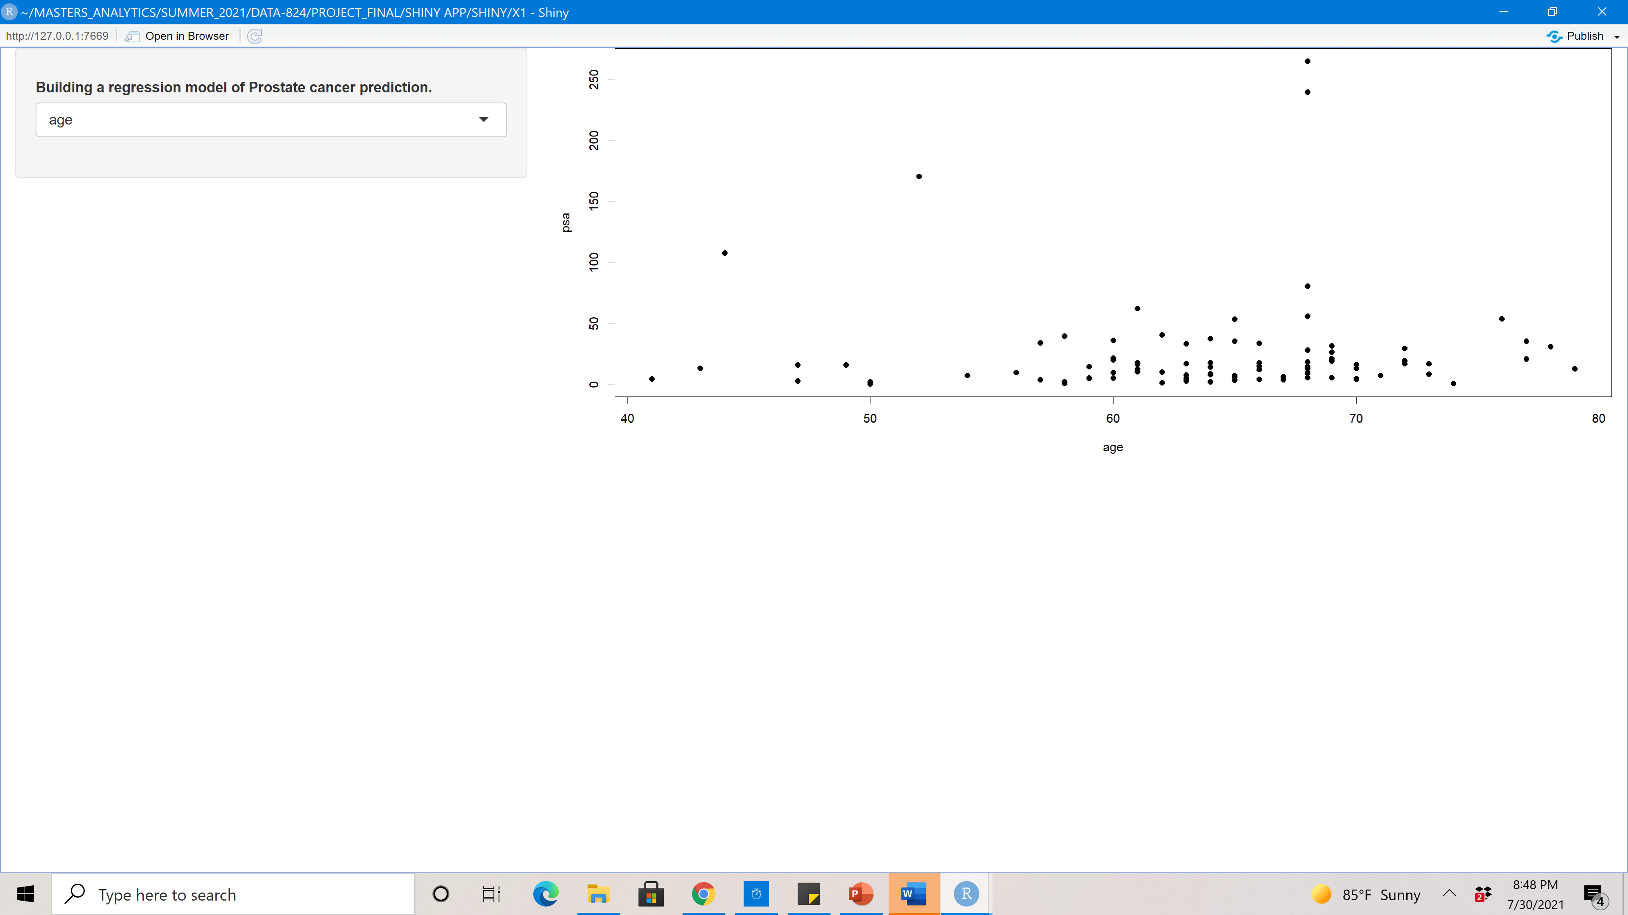
- The dotplot shows the distribution of independent variable age between 60 to 70 is more.

Slide 4
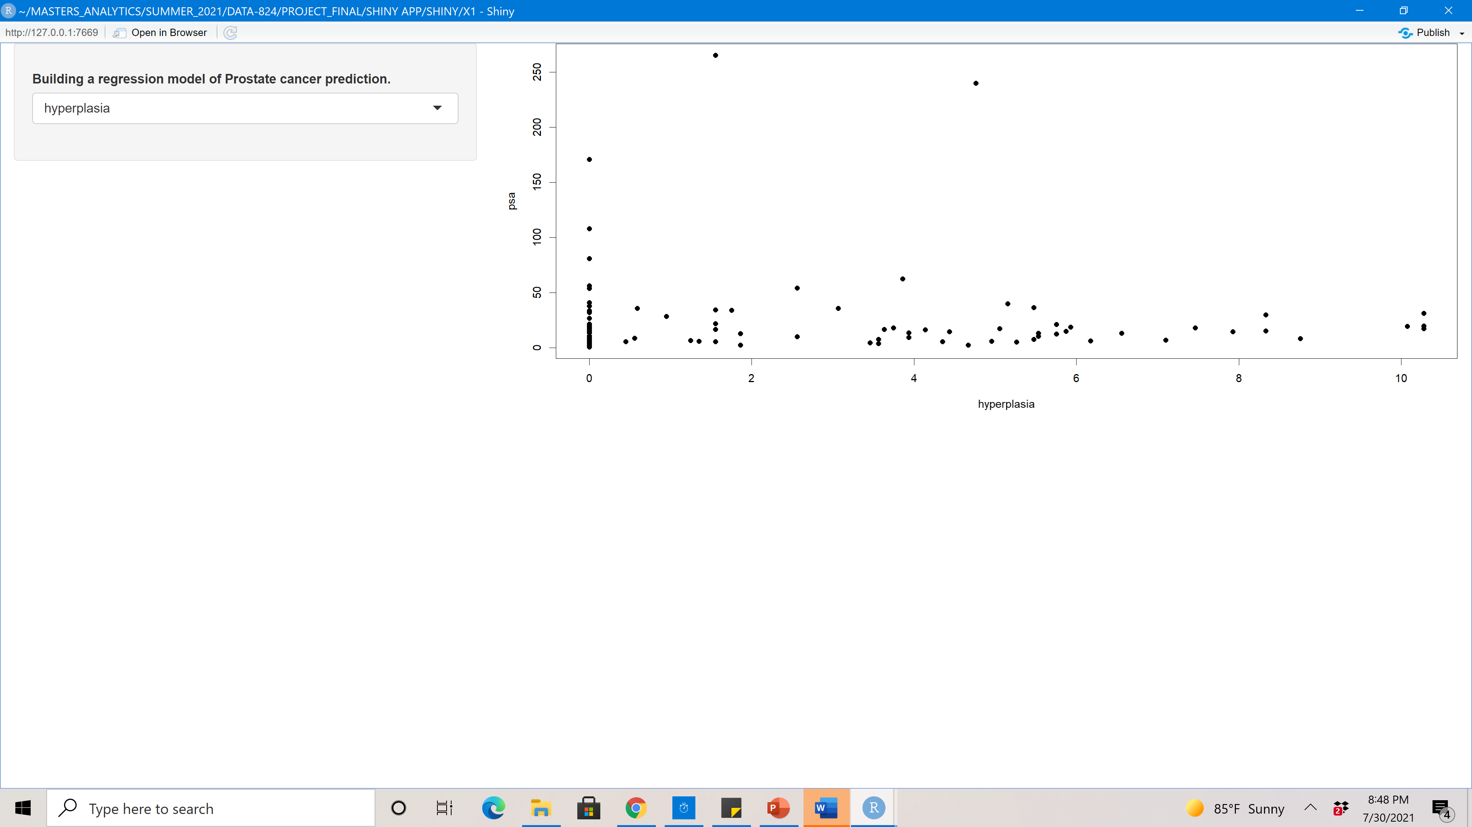
- The dotplot represents the linear relationship between psa level and hyperplasia. The residual are close to zero
and evenly distributed.

Slide 5
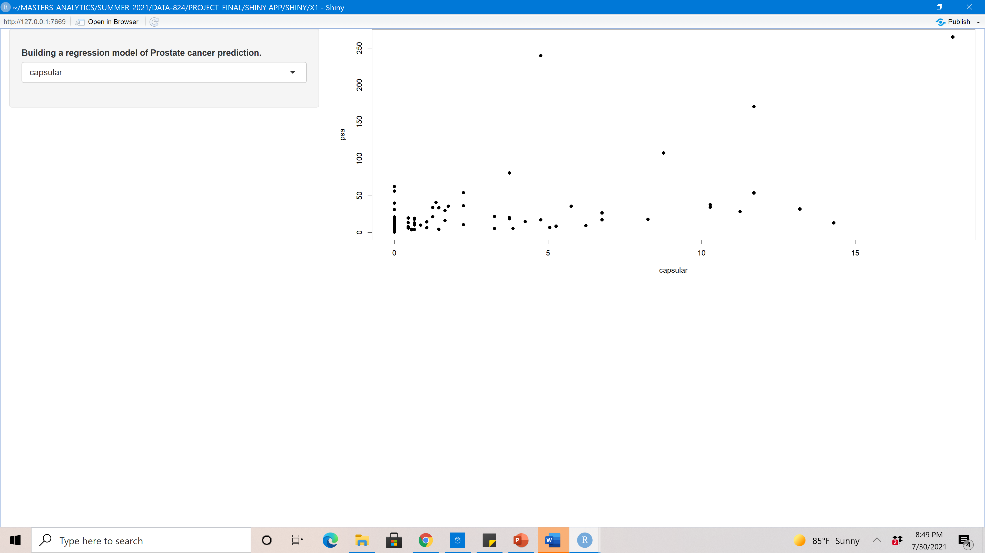
- The dotplot shows linear relationship between psa and capsular. Looks like plot has couple of outlier.

Slide 6
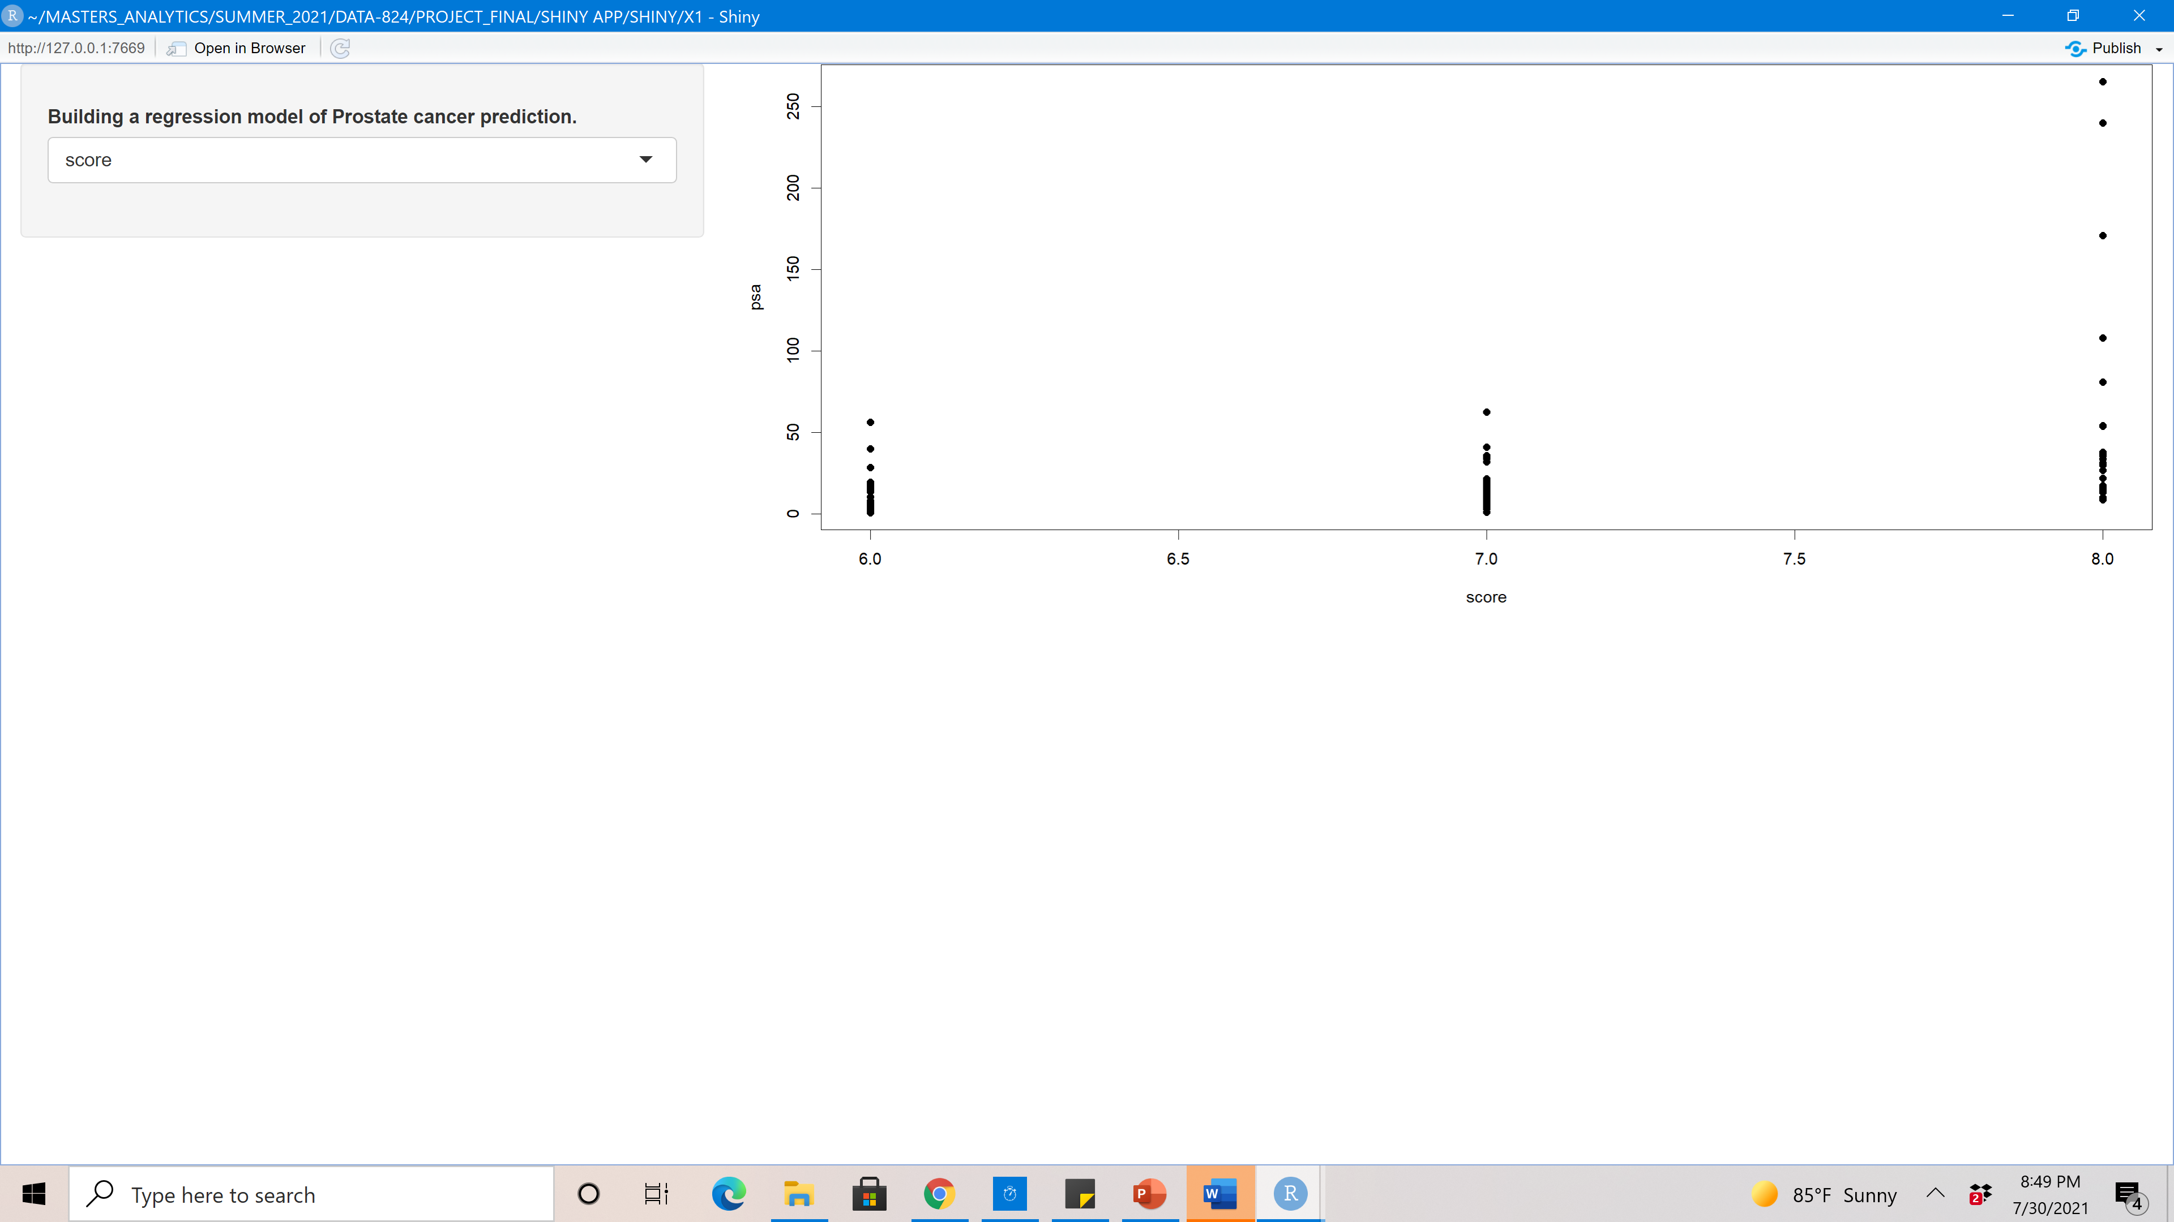
- The dotplot indicates that the residuals are distributed based on Gleason score which assigned to predict the stage of the cancer.

